Slide 1

Fundamentals of Data Structures
S. Y. B. Tech CSE
Trimester – III
SCHOOL OF COMPUTER ENGINEERING AND TECHNOLOGY

Slide 2

Queue
Topics to be Covered
Queue as an Abstract Data Type
Representation of Queue Using Sequential Organization
Applications of Queue

Slide 3


Queue
Unit : V

Slide 4

Queue
Queue as a Data Structure

Slide 5
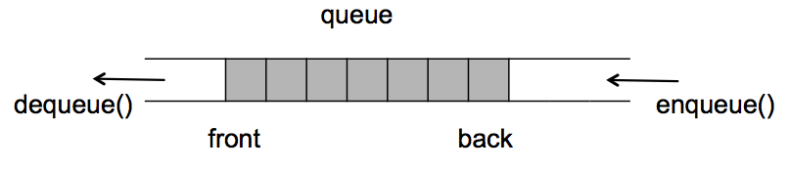
Queue
Queue is an ordered list (linear data structure) in which insertions(Enqueue) are done at rear end and deletions(dequeue) are done at the front end of the Queue.

Slide 6
ADT of Queue
CREATEQ(Q) which creates Q as an empty queue;
ADDQ(i,Q) which adds the element i to the rear of a queue and returns the new queue;
DELETEQ(Q) which removes the front element from the queue Q and returns the resulting queue;
FRONT(Q) which returns the front element of Q;
ISEMTQ(Q) which returns true if Q is empty else false.

Slide 7
ADT of Queue (Cont’)
A complete specification of this data structure is
structure QUEUE (item)
1 declare CREATEQ( ) queue
2 ADDQ(item,queue) 🡪queue
3 DELETEQ(queue) 🡪queue
4 FRONT(queue) 🡪item
5 ISEMTQ(queue) 🡪boolean;
6 for all Q queue, i item let
ISEMTQ(CREATEQ) :: = true
ISEMTQ(ADDQ(i,Q)) :: = false
DELETEQ(CREATEQ) :: = error
DELETEQ(ADDQ(i,Q)):: =
if ISEMTQ(Q) then CREATEQ
else ADDQ(i,DELETEQ(Q))
FRONT(CREATEQ) :: = error
FRONT(ADDQ(i,Q)) :: =
if ISEMTQ(Q) then i else FRONT(Q)
16 end
17 end QUEUE

Slide 8
Applications of Queue
Queues, like stacks, also arise quite naturally in the computer solution of many problems.
The most common occurrence of a queue in computer applications is for the scheduling of jobs.
In batch processing the jobs are ''queued-up'' as they are read-in and executed, one after another in the order they were received.

Slide 9
Operations on Queue
Adding an element at the rear of the Queue
Delete the front element from the queue
PeepRear returns the rear element of the queue
PeepFront returns the front element of the queue
isFull returns if queue is full
isEmpty returns if queue is empty

Slide 10
Adding a element
Algorithm AddQ(q[],elem)
{
if(isfull())
print “Queue is full ”
else
{ rear=rear+1
q[rear]=elem
}
}
int isfull()
{ if(rear==size-1)
return 1
else
return 0
}

Slide 11
Deleting an element from Queue
Algorithm DelQ(q[])
{
if(isempty())
return -1
else
{ front=front+1
elem=q[front]
return elem
}
}
int isempty()
{ if(rear==front)
return 1
else
return 0
}

Slide 12
Queue operations
AddQ(10)
AddQ(18)
E=delQ()
AddQ(20)
E=delQ()
E=delQ()
E=delQ()

Slide 13
Circular Queue
A more efficient queue representation is obtained by regarding the array Q(1:n) as circular. It now becomes more convenient to declare the array as Q(0:n - 1).
When rear = n - 1, the next element is entered at Q(0) in case that spot is free. Using the same conventions as before, front will always point one position counterclockwise from the first element in the queue.

Slide 14
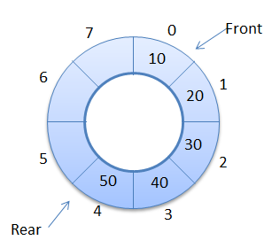
Circular Queue

Slide 15
Circular Queue
Initially front=rear=0
Algorithm AddCQ(elem)
{ //insert items in the CQ stored in Q[0..n-1]
//rear points to the last item & front is one
//position counter clockwise from the first
if (rear +1 ) %n== front
print “queue full”
else
{ rear=(rear+1) %n
Q[rear]=elem
}
}

Slide 16
Circular Queue
Initially front=rear=0
Algorithm DelCQ(elem)
{ //removes the front element of the queue
if front==rear
print “queue empty”
else
{ front=(front+1) %n
elem=Q[front]
return elem
}
}

Slide 17
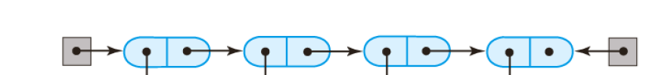
Linked Queue and Operations
front
rear
Queue implemented using Singly linked list

Slide 18
Linked Queue and Operations
Empty queue will have front and rear with the following conditions:
front->next=NULL
rear=NULL
---
rear = NULL;
front

Slide 19
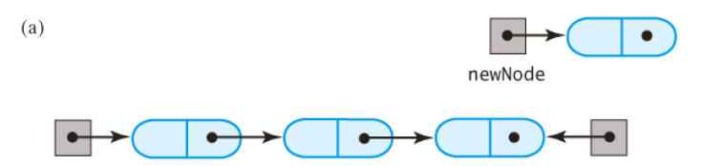
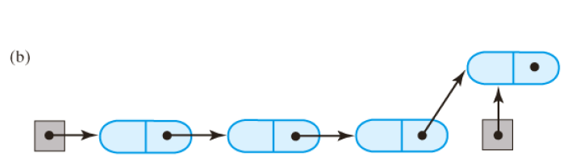
Linked Queue and Operations
front
rear
newNode
front
rear
Enqueue operation: a) New node created b) New node inserted (Enqueue complete)

Slide 20
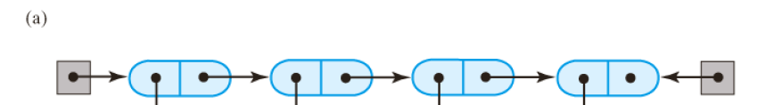
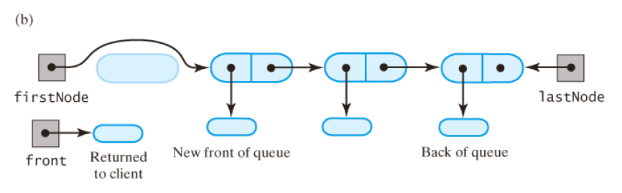
Linked Queue and Operations
front
rear
front
rear
Dequeue operation: a) Before deletion b) First node deleted (Dequeue complete)

Slide 21
Linked Queue and Operations
struct node
{
int data;
struct node *next;
};
struct node *front, *rear;
//following statements to be initialized in main
front=(struct node *) malloc(sizeof(struct node));
front->next=NULL;
rear=NULL;
int isempty()
{
if(front->next==NULL)
return 1;
else
return 0;
}

Slide 22
Linked Queue and Operations
void enqueue(int element )
{
//allocate memory to new_node
new_node->data=element;
new_node->next=NULL;
if(isempty())
{
front->next=rear=new_node;
}
else
{
rear->next=new_node;
rear=new_node;
}
}

Slide 23
Linked Queue and Operations
int dequeue()
{
if(isempty())
{
//print queue is empty
return -1;
}
else
{
temp = front->next;
value = temp->data;
front->next=temp->next;
temp->next=NULL;
free(temp);
return (value);
}
}

Slide 24
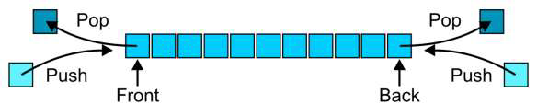
Double Ended Queue(Deque)
A double-ended queue (deque) is an abstract data type that generalizes a queue, for which elements can be added to or removed from either the front or rear.
Hybrid linear structure provides all the capabilities of stacks and queues in a single data structure.

Slide 25
Types of deque
Input-restricted deque
Deletion can be made from both ends , but Insertion can be made at one end only.
Output-restricted deque
Insertion can be made at both ends , but Deletion can be made from one end only.

Slide 26
deque Operations
pushRear() - Insert element at back
pushFront() - Insert element at front
popRear() - Remove last element
popFront() - Remove first element
isEmpty() – Checks whether the queue is empty or not.

Slide 27
deque Example
Operation | Deque content
pushFront(‘a’) | [‘a’]
pushFront(‘b’) | [‘b’ , ‘a’]
pushRear(‘c’) | [‘b’ , ‘a’ , ‘c’]
popFront() | [‘a’ , ‘c’]
popRear() | [‘a’]

Slide 28
Queue Applications: Job Scheduling
Job scheduling is the process of allocating system resources to many different tasks by an operating system (OS).
The system handles prioritized job queues that are awaiting CPU time and it should determine which job to be taken from which queue and the amount of time to be allocated for the job.
This type of scheduling makes sure that all jobs are carried out fairly and on time.
Job scheduling is performed using job schedulers. Job schedulers are programs that enable scheduling and, at times, track computer "batch" jobs, or units of work

Slide 29
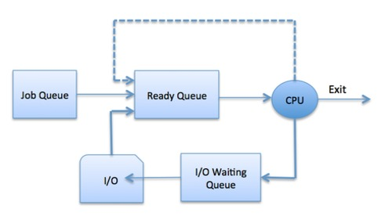
The Operating System maintains the following important process scheduling queues −
Job queue − This queue keeps all the processes in the system.
Ready queue − This queue keeps a set of all processes residing in main memory, ready and waiting to execute. A new process is always put in this queue.
Device queues − The processes which are blocked due to unavailability of an I/O device constitute this queue.

Slide 30
FAQS
Write an ADT for Queue
What are the primitive operations of Queue.
Explain with example Queue applications.

Slide 31
Takeaways
Queue is First in First Out(FIFO) Data Structure
Primitive operations on Queue are enqueue, dequeue,isEmpty and isFull
Queue can be represented by using Array as well as linked list.
Queue is commonly used in Job Sequencing by OS.

